Slide 1

Google Cloud Platform Cloud
Overview of Google Cloud Platform (GCP)

Slide 2
Benefits of Cloud Computing (in general)
“Pay-as-you-go” basis, use only what you need
Convert capital expenses into operating expenses
Focus on rapid innovation
Productivity enhanced due to no software installed
“Vertically integrated” stacks enhance functionality, performance, reliability, and security

Slide 3
What is Google Cloud Platform (GCP)
Google’s suite of cloud computing services
Runs on the same infrastructure and network as Google
Google’s worldwide collection of data centers
Hosts IaaS, PaaS, and SaaS use cases
At a basic level, it hosts and manages your computer infrastructure so you don’t have to
Does it at ‘Google-scale’

Slide 4
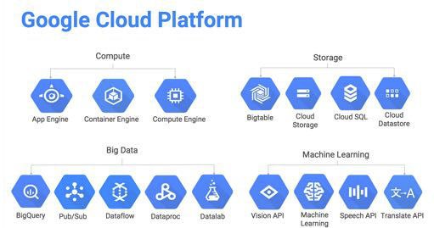
GCP at a glance

Slide 5
How does Google Cloud Platform stand out?
Access the same infrastructure Google uses for their own services
Customer friendly pricing (https://cloud.google.com/pricing)
Compute Engine instances billed per minute, not hour
Automatic sustained use discounts – no upfront commitment required
Private Global Fiber Network
Blazing fast
Data moving between data centers never leaves the private network
Live migration of Virtual Machines
Better performance
Website benchmarks showed as much as 50% improvement in loading speed
Instantly scalable. VM’s can auto-scale without shutting machine down.
Access to GPU’s for high end scientific computing and machine learning

Slide 6
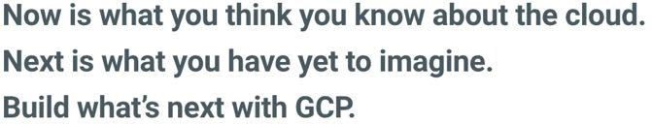
How does Google Cloud Platform stand out?
Industry leading security
Over 500 full time security professionals
All data encrypted in transit and at rest
Expansive audit compliance list
SSAE16, ISO 27017, ISO 27018, PCI, and HIPAA
Access to innovative resources not available anywhere else
Big Data, Machine Learning
API’s (Video Intelligence, Maps)
“Build what’s next”

Slide 7
Infrastructure breakdown
Data Centers
Regions and Zones
Backbone
High speed private fiber network
Points of Presence
connect Google's network to the rest of the internet
Edge Nodes
Closest to end users worldwide

Slide 8
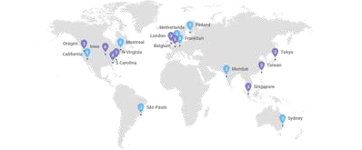

Datacenters - Worldwide presence
https://cloud.google.com/about/locations/

Slide 9
Cloud Regions and Zones
Nine regions split into 27 zones
Regions
Regions are specific geographical locations where you can run your resources
Collections of zones
Regional resources are available to resources in any zone in the region
Frequently expanding
Zones
Isolated physical locations within a region
Zonal resources are only available in that zone
Machines in different zones have no single point of failure
For example: an effective disaster recovery plan would have assets deployed across multiple zones, or even different regions.

Slide 10
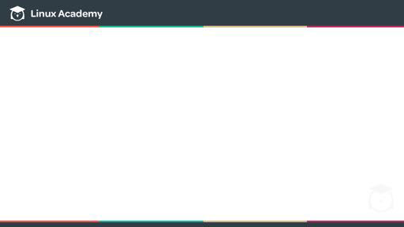
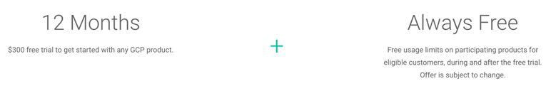
Free Trial and Always Free Tier
https://cloud.google.com/free/
Free trial + Always Free
Always free tier does not cut into free trial credit

Slide 11
Free Trial
$300 credit for 12 months
Trial ends when either credit is used up, or 12 months pass, whichever comes first
Requires credit card for trial, but does not auto-charge when trial runs out
When upgrading to full account, free credit/time still remains and will be auto-charged after credit runs out
Trial limitations (not exhaustive list)
Compute Engine
No more than 8 cores running at once (across all instances)
No more than 100GB solid state disk (SSD) space
2TB persistent standard disk space

Slide 12
Always Free Tier
Try GCP products for free up to usage limits
Used for testing/experimenting
Only for US regions (does not apply to App Engine)
Limits apply to all projects across all regions per account
Example: 5GB Cloud Storage can be used in one region, or split across 2 regions
Usage beyond Always Free limitations will be charged to free trial credit or billed if trial is expired
Always Free tier never expires
For example:
Compute Engine
1 f1-micro instance per month (US regions only)
30 GB-months HDD, 5 GB-months snapshot
More info for usage limits: https://cloud.google.com/free/docs/always-free-usage-limits

Slide 13
Signing up for GCP account
Requires Google account
Can use non-Gmail email to associate with Google account

Slide 14
Let’s get started!

Slide 15
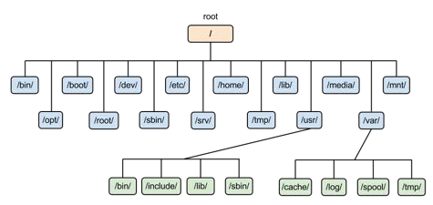
GCP Organization hierarchy
Like any operating system or complex tech resource, some form of organization and access control is a necessity
GCP’s implementation is called Cloud Resource Hierarchy

Slide 16
Purpose of the Cloud Resource Hierarchy
Provide a hierarchy of ownership
Identity and Access Management (IAM)
Provide attach points and inheritance for access control and organization policies.

Slide 17
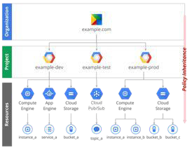
Hierarchy Overview
Organization (not applicable to individual accounts)
Projects
Resources

Slide 18
What are Projects?
Core organizational component of GCP
Control access to resources
Who has access to what?
Creating, enabling, and using all Cloud Platform services
Per project basis
Permissions
Billing
API’s

Slide 19
Three identifying attributes
Project Name – aka “Friendly Name”
Project ID
Also known as Application ID
Project Number
Used in various places for identifying resources that belong to specific projects. For example, service account access and names

Slide 20
Your Homework
Access Project Manager
Create a project
Choose a friendly name
Watch how Project ID is automatically created from friendly name
Look up Project info after creation
Delete your Project
Create new Project – “My First Project”
Do NOT delete this Project!

Slide 21
What we are covering
Discuss the importance of resource access and management
Overview of GCP’s implementation of Identity and Access Management (IAS)
Members, Roles, Resources
What are Members?
Primitive and Predefined Roles
IAM Policy Hierarchy
Hands on demo

Slide 22
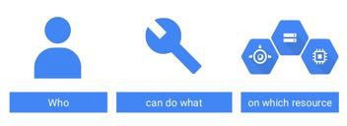
For any organization:

Slide 23
Why is this important?
Important to provide granular access to resources
Prevent unwanted access to other resources
Adopt the security principle of least privilege

Slide 24
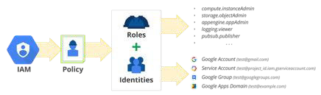
How does this relate to GCP?
Cloud Identity and Access Management (Cloud IAM)
Members (who) are granted permissions and roles (what) to GCP services (resource) using the principle of
least privilege

Slide 25
What is a member (the ‘who’)?
Can be either a person or a service account
People
Google account
Google group – e.g. DevTeam@mycompany.com
G Suite Domain
Cloud Identity domain (Beta)
Organization domain that is not a Google domain/account
Service account
Application access

Slide 26
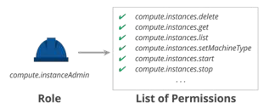
What is a Role (the ‘what’)?
Collection of permissions to give access to a given resource
Permissions represented in form <service>.<resource>.<verb>. E.g.: compute.instances.delete
Permissions vs. roles
Users are not directly assigned permissions, but are assigned roles which contain a collection of permissions

Slide 27
Primitive vs Predefined (Curated) Roles
Primitive
Historically available GCP roles before Cloud IAM was implemented.
Applied to Project level
Broad roles
Viewer
Read only actions that preserve state (i.e. cannot make changes)
Editor
Same as above + can modify state
Owner
Same as above + manage access to project and all project resources
Set up project billing

Slide 28
Predefined (or Curated) Roles
Much more granular access, prevent unwanted access to other resources
Granted at resource level
Example: App Engine Admin – Full access to only App Engine resources
Multiple predefined roles can be given to individual users
All current Predefined Roles - https://cloud.google.com/iam/docs/understanding-roles#predefined_roles

Slide 29
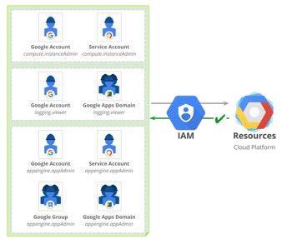
IAM Policy
Collection of statements that define who has what type of access
Full list of roles granted to a member to a resource

Slide 30
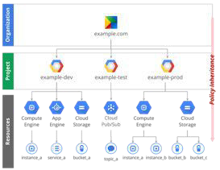
Policy Hierarchy
Resource access is organized hierarchically, from the Organization down to the Resources
Organization → Project → Resources – parent/child format
Each child has exactly one parent
Children inherit Parent roles
Parent policies overrule restrictive child policies

Slide 31
Roles - Putting it all together
Roles are a collection of individual permissions
Roles are assigned to members, not permissions directly
Roles include Primitive (broad) and Predefined (granular)
IAM Policy is a full list of roles granted to members on a resource
IAM Policies are hierarchally defined, with parent overruling child policy

Slide 32
Resources
At lowest level, fundamental components of GCP
Compute Engine VM’s
Google Cloud Storage Buckets
Includes Organization, Projects, GCP Services and resources inside

Slide 33
Putting ALL of it together – IAM….
…grants members… (users, groups, organizations, service accounts)
…various roles… – primitive (broad) and predefined (granular)
…in a hierarchal format… - parent overrules child
…to GCP Resources – all resources into the GCP Hierarchy
Examples
joe@gmail.com is granted Owner role to Project ‘My First Project’
my-first-project-172354@developer.gserviceaccount.com granted App Engine Service Admin role to App Engine

Slide 34
What we will cover
Introduce the three methods of interacting with GCP
Cloud console (web interface)
Google Cloud SDK (Software Development Kit)
RESTful API
Following lessons will be hands on demos of the above

Slide 35
Cloud Console
Centralized access to all your Google Cloud Platform projects.
Access to the Google Cloud Shell
A customizable project dashboard, with an overview of Google Cloud resources, billing, and a filterable activity listing
Easy access to all Google Cloud Platform APIs, with a dashboard specific to each API, and access to manage your resources
Links to Google Cloud Platform starting points, news, and documentation
Essentially a ‘one stop shop’ for all that GCP has to offer
Full tour next lesson

Slide 36
Google Cloud SDK
SDK = Software Development Kit
Command line interface (CLI) tools for managing resources and applications on GCP
Includes gcloud, gsutil, and bq CLI tools
gcloud – many common GCP tasks
gsutil – access Cloud Storage
bq – work with data in BigQuery
Can be locally installed as Docker image or ran from Cloud Shell
Install from https://cloud.google.com/sdk

Slide 37
Cloud Shell
Interactive web based shell environment for GCP, accessed from the web console
Easy to manage resources without having to install the Google Cloud SDK locally, and comes with all necessary tools built in. Always available when you need it.
Includes:
A temporary Compute Engine virtual machine instance
Command-line access to the instance from a web browser
5 GB of persistent disk storage
Pre-installed Google Cloud SDK and other tools
Language support for Java, Go, Python, Node.js, PHP and Ruby
Web preview functionality
Built-in authorization for access to Cloud Platform Console projects and resources

Slide 38
Restful API’s (Application Program Interface)
Per Google: “Intended for software developers”
Programmatic access to GCP resources
Typically use JSON as an interchange format
Use OAuth 2.0 for authentication and authorization
Enabled via GCP Console
Most API’s have daily quota’s that can be raised upon request
Plan ahead for capacity
Can experiment with APIs Explorer

Slide 39
API Explorer
Interactive tool to easily try Google APIs using a browser
Browse available APIs and versions.
View methods, parameters, and inline documentation.
Execute requests for any method and see responses in real time.
Make authenticated and authorized API calls with ease.
Additionally, other client libraries are able to interact with GCP APIs
Go, Java, Node.js, Python, Ruby, PHP, and C#

Slide 40
DEMO TIME

Slide 41
What we will cover
Review Cloud Shell
gcloud commands overview
Where to find command reference
Hands on demo

Slide 42
Cloud Shell
Pre-configured Google SDK Linux instance
Automatic authentication based on GCP Console login
Accessible from any web browser within Cloud Console
All client libraries for web applications pre-installed
Includes built in code editor
5GB persistent storage
Preview web apps before deployment
Nothing to install!

Slide 43
Limitations
1 hour time out for inactivity
Machine will terminate/self-delete
$HOME directory contents will be preserved for new session
Direct interactive use only
Not for running high computational/network workloads
If in violation, session can be terminated without notice
For long periods of inactivity, home disk may be recycled (with advance notice via email)
If need longer inactive period, consider either local installed SDK or use Google Cloud Storage for long term storage

Slide 44
gcloud commands
For Cloud Shell and local installed Google Cloud SDK
Manage Google Cloud Platform resources and developer workflow
(Typical) command format:
gcloud [GROUP] [GROUP] [COMMAND]—arguments
Examples:
gcloud compute instances create instance-1 --zone us-central1-a
gcloud config set project my-unique-project-id
Full gcloud command list at https://cloud.google.com/sdk/gcloud/reference/

Slide 45
Do it!.

Slide 46
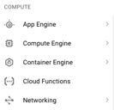
Choosing Correct Compute Option
Multiple Compute Options for Hosting Applications
Compute Option = method for hosting applications on GCP
Google Compute Engine
Google App Engine
Google Container Engine
Google Cloud Functions (Beta)
Each option can take advantage of the rest of GCP services
Storage
Networking
Big Data
Security

Slide 47

Role of the Google Cloud Architect
Given a set of business and technical requirements, know how to choose and implement the right tool for the task

Slide 48
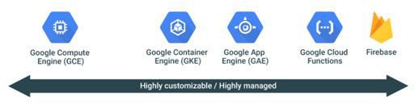
Which one should we pick?
Choose the best option for your requirements
Each option has their pros and cons
Sliding scale of flexibility vs. managed
Can combine options

Slide 49
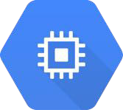
Compute Options Overview – Compute Engine
Infrastructure as a Service (IaaS)
Virtual machines – referred to as ‘instances’
Virtual version of physical PC
CPU/GPU
Memory
Disk space
OS
Firewall controls
Network connection/management (VPN, load balancing)
Offers complete control and most flexibility, but also comes with most operational overhead.
Great fit for organizations moving existing servers into the cloud and are used to managing VM’s

Slide 50
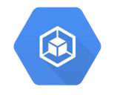
Compute Options Overview – Container Engine
Deploy containerized applications
De-couples application components from OS
Run app in multiple environments, regardless of OS
Powered by Kubernetes – open source container orchestration system
“Manage applications, not machines”

Slide 51
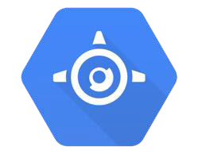
Compute Options Overview – App Engine
Platform as a Service (PaaS)
Developers can focus on writing code, while Google handles the rest
Build scalable web applications and mobile backends
Managed service
Never touch the underlying infrastructure
Deployment, maintenance, and scalability handled
Reduces operational overhead
Standard and Flexible environments
Standard supports Python, Java, PHP, Go
Flexible natively supports Java 8 / Servlet 3.1 / Jetty 9, Python 2.7 and Python 3.5, Node.js, Ruby, PHP,
.NET core, and Go, plus any other runtime if using a custom Docker image

Slide 52
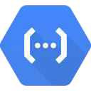
Cloud Functions (BETA)
Serverless environment for building and connecting cloud services
Event-driven
Function executes as a ‘trigger’ in response to a cloud based event
Simple, single purpose functions
Written in Javascript and execute in Node.js
Example: A file is uploaded to Cloud Storage (event), function executes in response to event (trigger)
Easier and less expensive than provisioning a server to watch for events

Slide 53
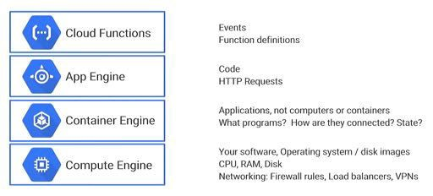
Comparisons – What do you want to think about?

Slide 54
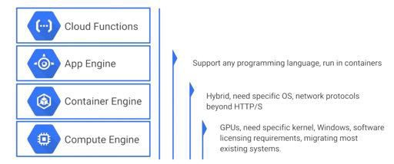
Comparisons – Technical Requirements

Slide 55
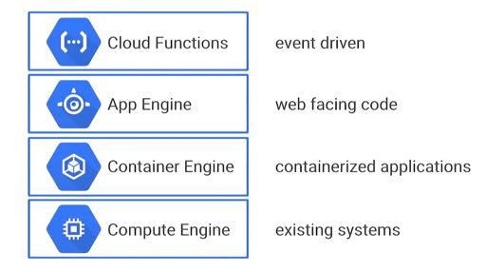
To summarize:

Slide 56
What is Infrastructure as a Service?
One of three cloud computing models, the other two being Platform as a Service (PaaS) and Software as a Service (SaaS)
Often referred to as the core layer of cloud computing. Behind the scenes, PaaS and SaaS are running on an IaaS layer.
It is a form of cloud computing that provides virtualized computing resources over the Internet
Deals with Virtual Machines and (in some cases) virtual networks

Slide 57
That’s great…what is ‘infrastructure’?

Slide 58
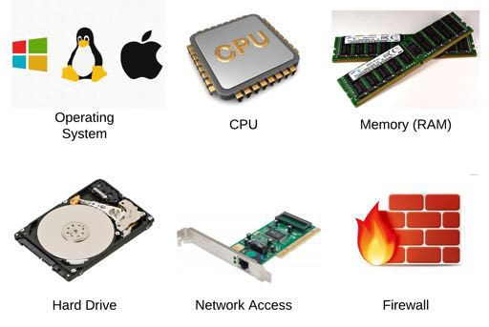
Traditional infrastructure (PC/server) components

Slide 59
Virtual Machine defined
Virtual version of a physical PC/server. Just as a physical computer has a CPU, memory, hard drive, an operating system, network access, and firewall to manage network traffic, so does a virtual machine.
Like a physical machine, it is up to the customer to manage the above aspects, as well as perform typical OS maintenance such as updates.
However, Virtual Machines have many advantages compared to traditional physical infrastructure.

Slide 60
What is Google Compute Engine?
Compute Engine is IaaS running virtual machines (instances)
Run high scale workloads on Google’s infrastructure
Create Linux and Windows instances
Robust network features
Custom networks
Firewall rules
Regional HTTP(s) load balancing
Network load balancing
Subnetworks

Slide 61
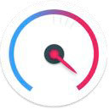
What makes Google Compute Engine unique?
Industry Leading Price & Performance
Compute Engine VMs boot quickly and are consistently high performance.
Offers local solid state drive (SSD) performance.
Positioned as the higher performance option
“Google Compute Engine ranked #1 in price-performance” (https://lp.google-mkto.com/rs/248-TPC- 286/images/Cloud-Spectator-Best-Hyperscale-Cloud-Providers.pdf)

Slide 62
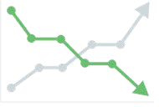

What makes Google Compute Engine unique?
Low Cost + Automatic Discounts
Google bills in minute-level increments (with a 10-minute minimum charge)
Automatic sustained use discounts for long-running workloads
No up-front commitment required
High speed, secure, private network
Global private fiber network
Connections between data centers on private high speed connections
Same network infrastructure used by Google

Slide 63
What makes Google Compute Engine unique?
Extremely Flexible
Create custom images
Low cost Pre-emptible VM’s for batch workloads
Custom machine types (CPU/memory specs)
Resize disks with no downtime
Create metadata and startup scripts

Slide 64
For the rest of this section
Micro-lessons
Cover the ‘basics’
We will learn:
Create, manage, and delete instances
Configure ‘basic’ instance options before and after creation
Connect to Linux and Windows instance
Attaching and resizing disks
Snapshots
Some gcloud command line reference

Slide 65
Our goal:
Become comfortable creating, managing, and connecting to Linux and Windows instances

Slide 66
What is Cloud Launcher?
“The fastest way to get started on GCP”
Quickly deploy functional software packages that run on GCP
Search for different solutions
In some cases, several variations of the same solution
Manage and view info with Deployment Manager
Most packages are free minus normal usage fees, however some are billed through a third party at an additional cost

Slide 67
High level overview of:
Virtual Private Cloud (VPC) networks
External IP addressing
Firewall Rules
Routes
Load Balancing
Cloud DNS
VPN/Cloud Routers
Cloud Content Delivery Network (CDN)

Slide 68
Virtual Private Cloud (VPC) Networks
Virtual version of the traditional physical network
A VPC network provides connectivity for your Compute Engine instances, Container Engine containers, and App Engine Flex services
All GCP projects start with a ‘default’ network
Resources in a VPC have an internal (private) IP address that is drawn from its subnet
All other Networking services are tied to a VPC

